Slide 1
The Design of
Safety Vectors on the Star Graph
Sheng-I Yeh, Chang-Biau Yang, Hon-Chan Chen, Kuo-Si Huang
Presenter: Chiao-Wei Chiu (邱喬偉)
Date: Sep. 7, 2006

Slide 2
Abstract
The concept of the safety vector can guide an efficient fault-tolerant routing on interconnection networks. The safety vector on the hypercube is based on the distance of a pair of nodes. However, the distance measure cannot be applied on the star graph directly since there are more than one routing path pattern on the star graph when the distances of two pairs of nodes are the same. In this paper, we first define the routing path pattern and path structure. And then, based on the definition, we propose the ways for constructing the safety vector of the star graph.

Slide 3
Abstract (cont.)
The undirected safety vector of the star graph is a one-dimensional vector on each node. For increasing the accuracy of selecting routing paths, we further propose the directed safety vector, which is a two-dimensional vector on each node. The routing ability of our directed safety vector is superior to that of the safety level of the star graph. When we calculate the safety vector of one node, we have to access the safety vectors (storing the routing abilities of path patterns) of its neighboring nodes. Thus, we also propose a ranking method to rank the path patterns.

Slide 4
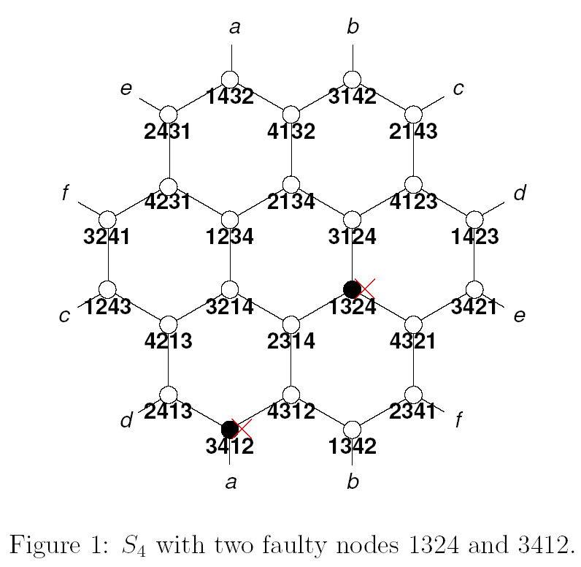

Star Graph
Let u = 1234, then
  u⁽²⁾ = 2134
  u⁽³⁾ = 3214
  u⁽⁴⁾ = 4231

Slide 5

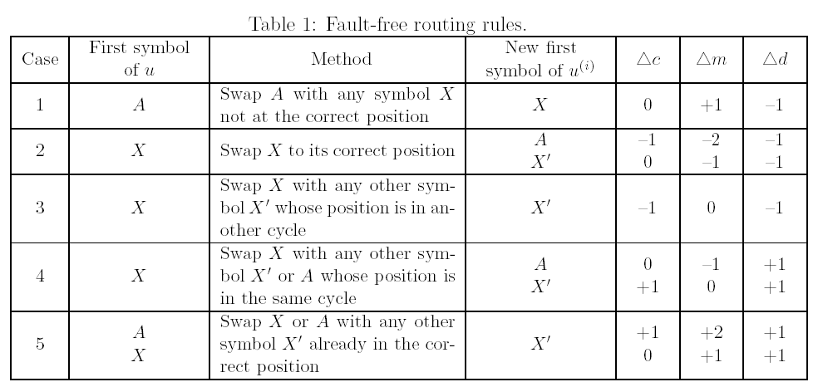
Routing Rules
c: cycles
m: difference
d(π): distance

Slide 6




Pattern
‘A’ : the first symbol of destination node
‘X’: others
All patterns of S₄ : ( ), (XA), (XXA), (XXXA), (XX), (XXX), and (XA)(XX),
(XA)(XX):
(XXX):

Slide 7
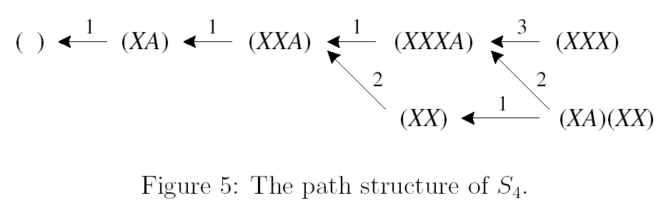
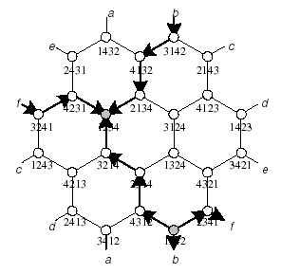
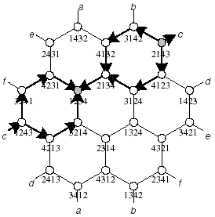

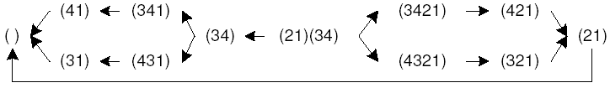
Path Structure of S₄

Slide 8
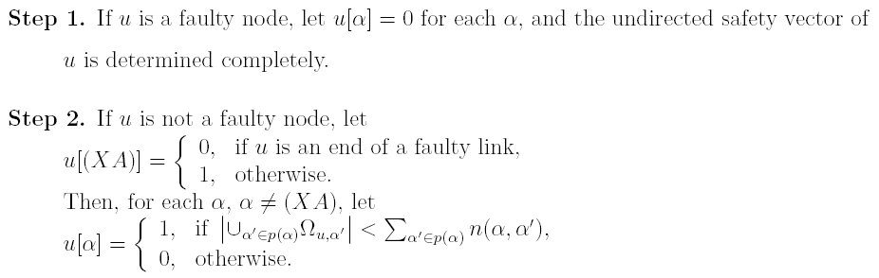
Computing the Safety Vector

Slide 9
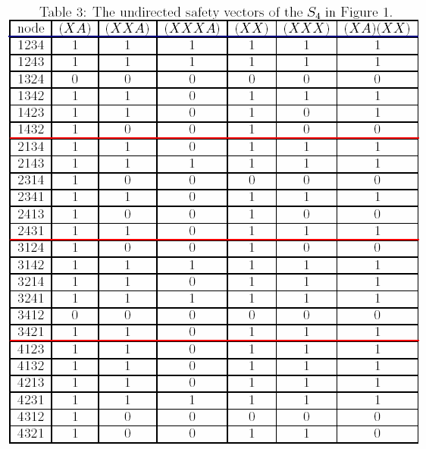
Safety Vectors in Fig.1

Slide 10
Demo
Distance of 2 nodes
Computing the Safety Vector

Slide 11
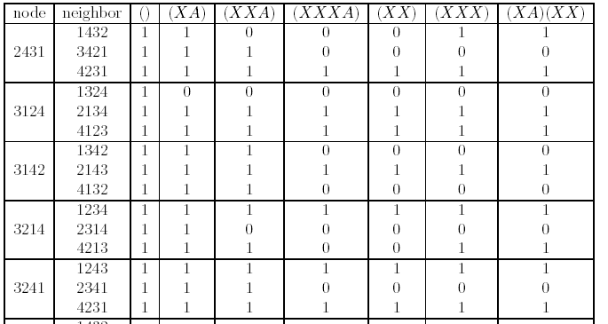
Directed Safety Vector
Each node u stores the safety vectors of all its neighbors
…

Slide 12
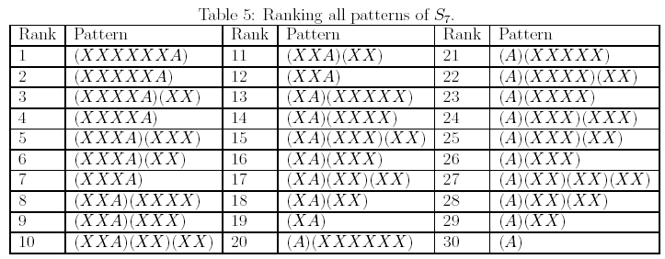
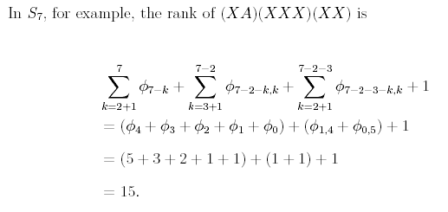
Rank of a Safety Vector

